Slide 1
VTT7 Intro til mikrosimulering og SUMO
Kursusgang 4

Slide 2
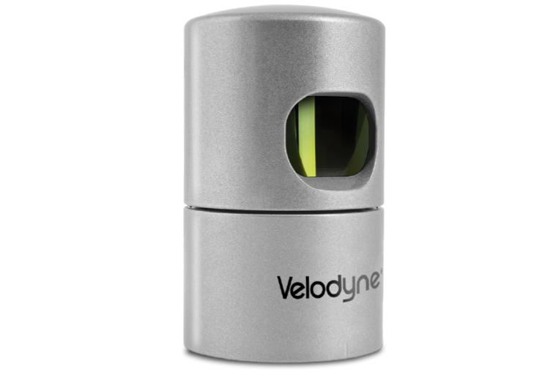
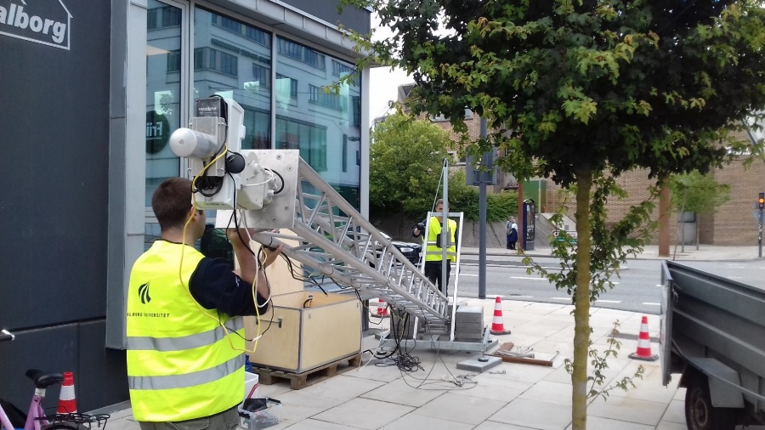
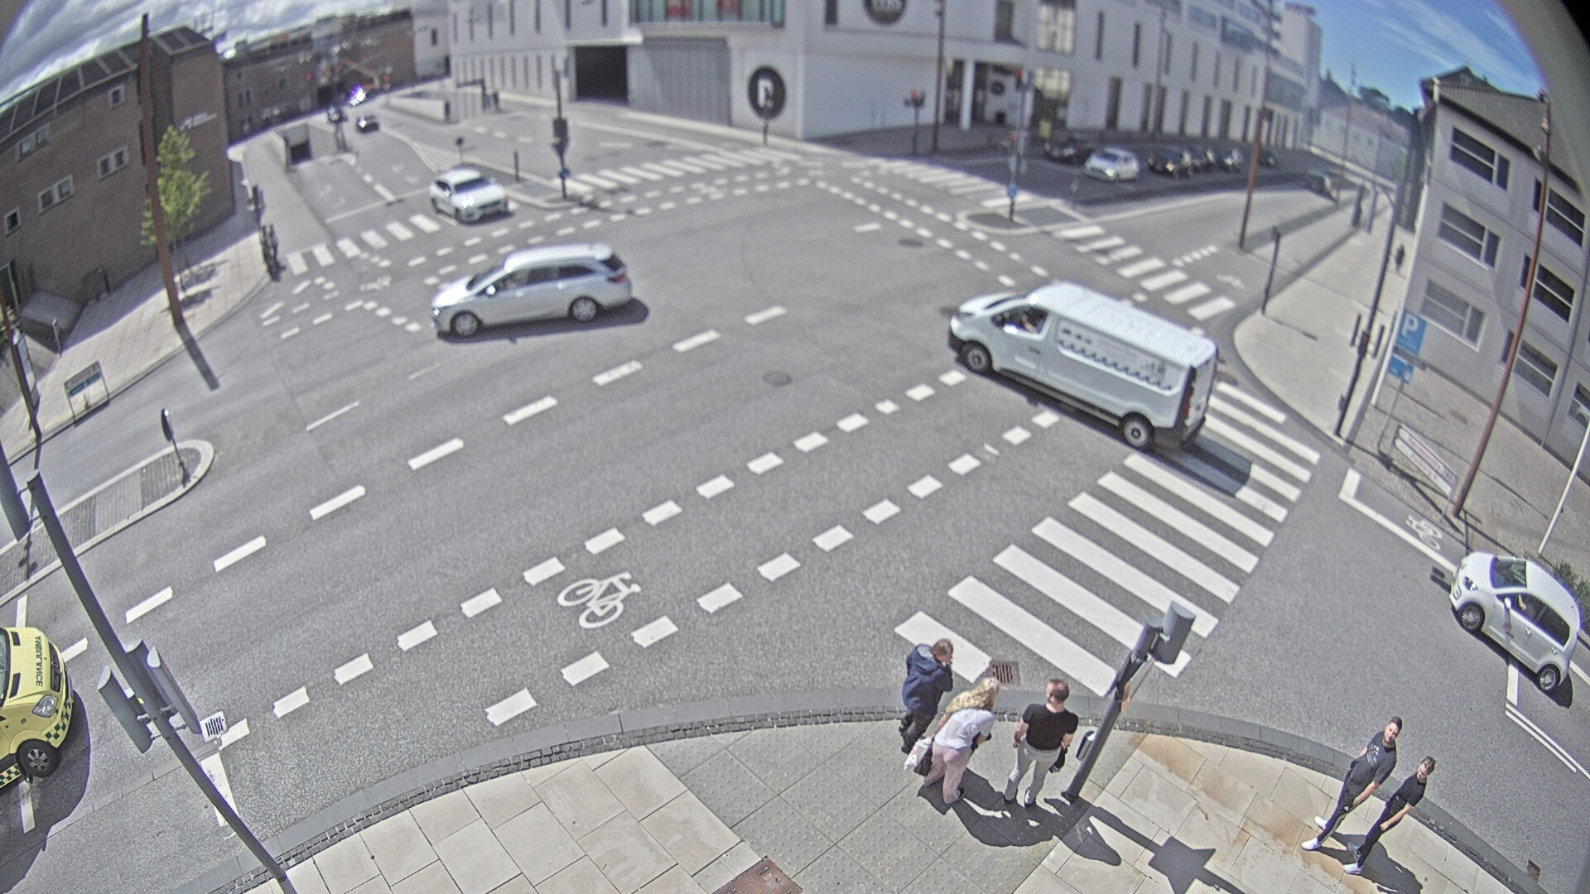
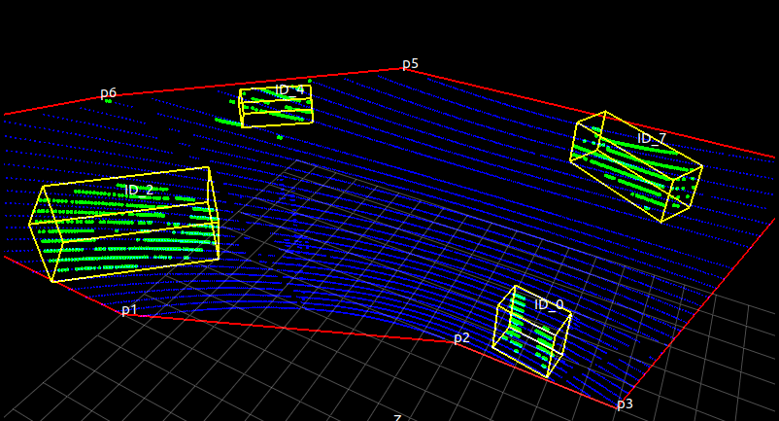
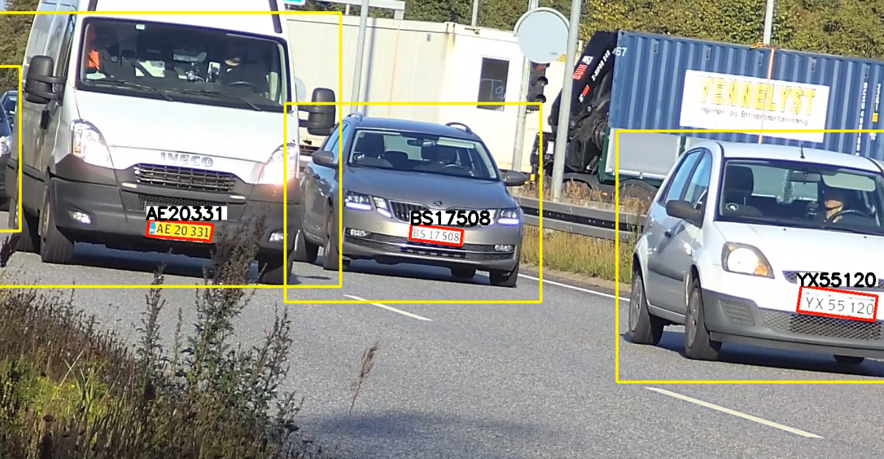
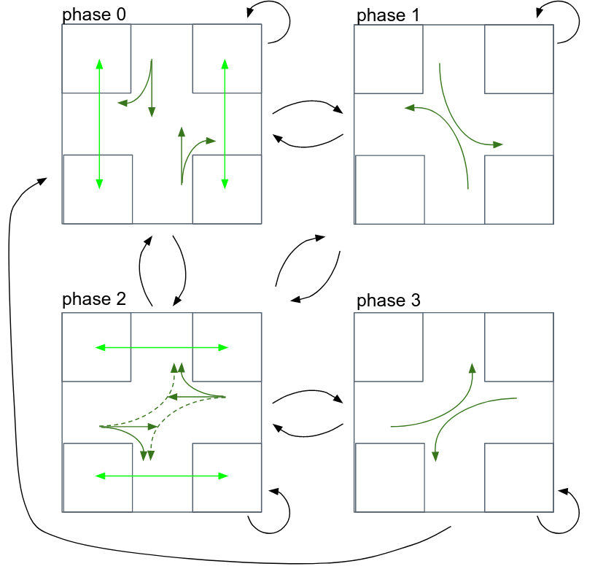
Who am i?
Finished AAU in 2018 as a structural engineer, now in the middle of a career shift to a software developer with focus on computer vision.
Have been a research assistant since 2018 and worked mostly with sensor data processing:
pylidartracker - traffic analysis from point clouds resulted in a master thesis of Malthe Sigurd Birkemose Holm: https://projekter.aau.dk/projekter/da/studentthesis/lidar-til-cykeldetektering(da74f7e5-656d-4d62-ac8f-4fe09523d9f0).html
Automatic license plate recognition
Last year was working on a PhD together with the computer science department on signalized intersection controlled with reinforcement learning based on radar measurements.
Notes:
Img sources: https://velodynelidar.com/products/hdl-32e/

Slide 3
Plan for the min course
Goals:
Get familiar with basic principles of building a simple traffic scenario in SUMO
Get familiar with time and demand based traffic control in SUMO
Advanced features, SUMO toolchain, task automation, etc
Typical lesson structure:
Before the lecture
Selfstudy given material on Moodle
During the lecture
Review session 1, review / recap materials, run an example in the class <30 min
Exercise <1h
Review session 2, review / recap materials, run an example in the class <30 min
Exercise <1h

Slide 4
Plan for today
Goals:
Get familiar with basic principles of building a simple traffic scenario in SUMO
You have already done:
Go through the prerequisite page and make sure software tools are installed and working.
Read course literature for lecture 4 found below. Lopez et. al 2018 - Microscopic Traffic Simulation using SUMO
Watch / follow along an intro video to SUMO network simulation.
Lecture 4 - SUMO basics
Introduction
Microsimulation in general
Refresher on used tools and skills
Simple network generation and simple demand generation
Exercise 1 - small network building and simulation
More detailed network generation and demand generation
Exercise 2 - edit / extend small network and add demands

Slide 5
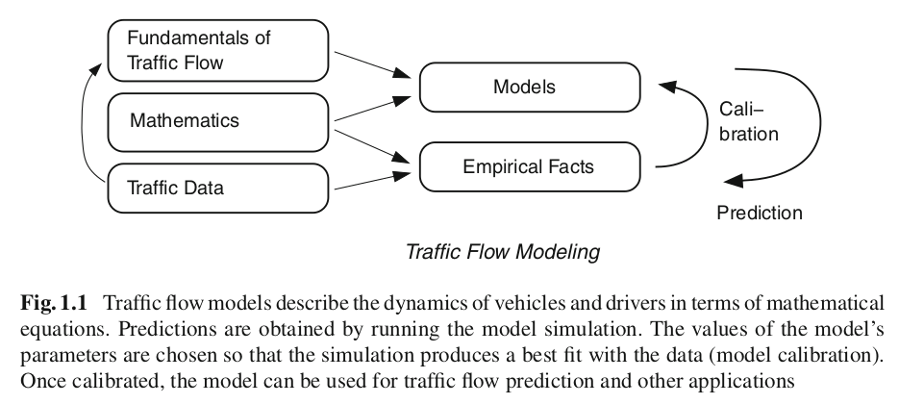
Traffic simulation
Why can we simulate traffic, an inherently human decision process?
Because we can describe it using:
A flexible mathematical model that can be tuned to closely replicate traffic data.
Large amount of data about traffic flow at different scales from, fx: detectors, GPS, wireless LAN, mobile phones inside the vehicles to tune the mathematical model.
[1]

Slide 6
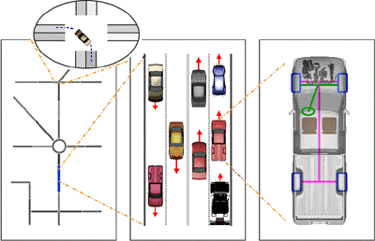
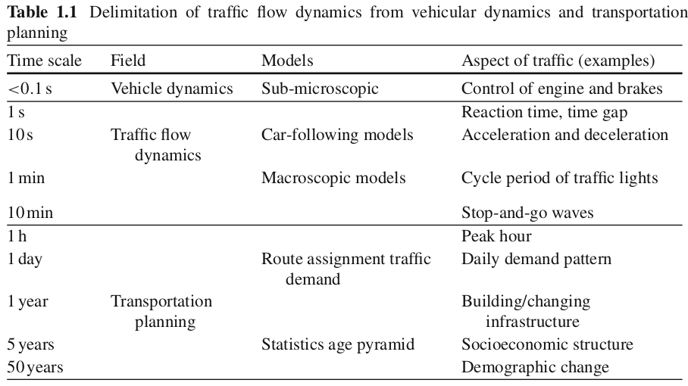
Classification of traffic representations
Phenomena at different scales are described by different mathematical models.
Solutions to the models at the slower time scales are the boundary conditions for the problems at the faster time scale.
Example: solution of transport planning problem -> demand (veh/h) on a link defines the input flow for the microscopic model that will in turn let us describe precise vehicle positions, velocities and accelerations
aka microscopic
[1]

Slide 7
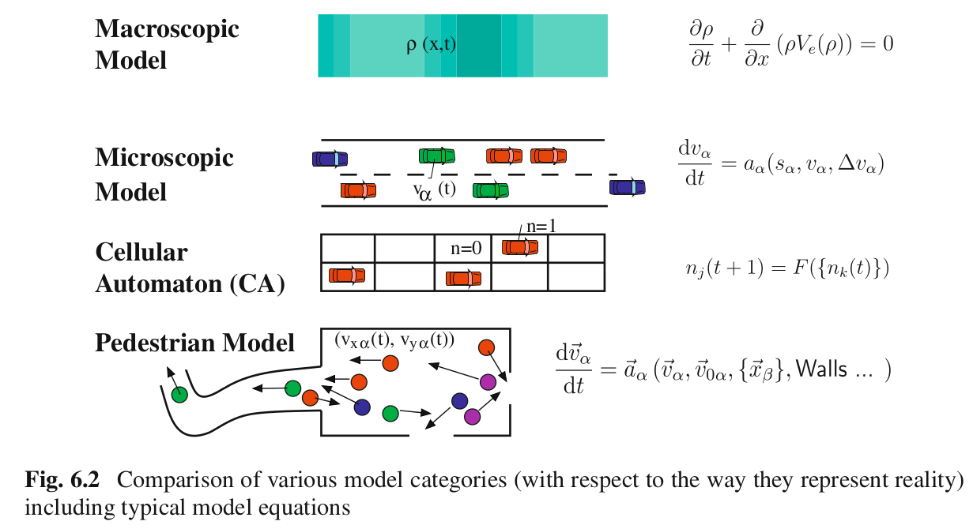
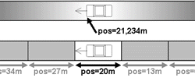
Trafik model types
Classification by the level of detail of desired output
Macro - quantities aggregated over an entire link: traffic density, flow, mean speed, speed variance
Micro - quantities belonging to each “car-driver particle” vehicle position, speeds, accelerations, stop counts, travel times.
Classification by continuity of space
Continuous - positions and velocities are decimal coordinates on an edge (Microscopic) or a vector in area (Pedestrian)
Discrete - position is an integer number of occupied cell (CA)
[1]
Notes:
https://sumo.dlr.de/docs/Theory/Traffic_Simulations.html
Macro works with aggregate variables, not suitable for advaced studies effect of ITS on driver behavior because there is no definition driver behaviour in the model

Slide 8
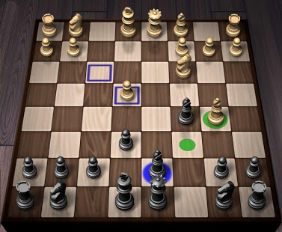
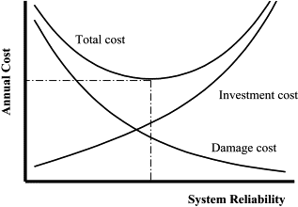
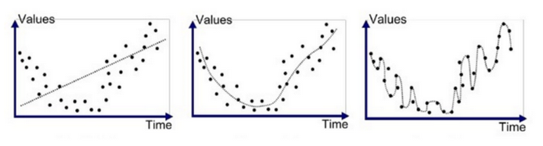
Why do we need a model for anything?
Can`t we go from experience of what works and what doesn't? Experience can be quite expensive or / and dangerous. A good model can support or substitute an experiment.
What`s a good model? “All models are wrong but some are useful” - statistician George Box
All models are approximations of reality. Only very limited amount of physical things can be represented exactly, for example, a chess game.
The more detailed the model, the more complex phenomena we can describe, however, very complex models are also hungry for time and computation resources. Our job is to find the best balance between the model complexity and the model cost.
Notes:
Img sources https://www.sciencedirect.com/science/article/pii/S0142061500000466
https://medium.com/greyatom/what-is-underfitting-and-overfitting-in-machine-learning-and-how-to-deal-with-it-6803a989c76

Slide 9
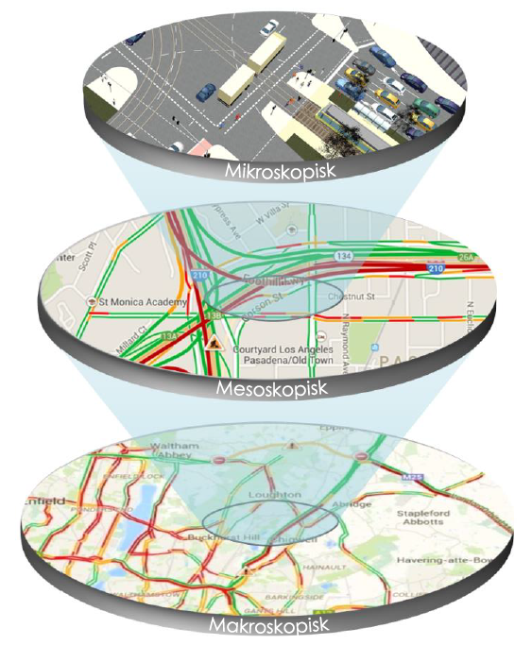
Applications of traffic models
There are numerous applications for traffic flow dynamics and simulation including the following:
generation of surrounding traffic in driving simulators and games (Microscopic)
model-based online traffic-state recognition and short-term prediction as input for traffic information channels (Macroscopic)
determining the optimal routes in connected (traffic-dependent) navigation systems (Macroscopic)
planning and optimizing the logic of highway traffic control such as variable message signs or ramp metering (Micro and macroscopic)
optimizing the logic behind the operation of urban traffic lights, e.g., enabling robust “green traffic waves” by a progressive signal system (Micro and macroscopic)
assessing traffic-related effects of advanced driver-assistance systems and telematic / connectivity applications in the field of Intelligent Transportation Systems (ITS) (Microscopic)
simulating in great detail the environmental effects of traffic operations such as fuel consumption and CO2 emission (Micro and macroscopic)

Slide 10
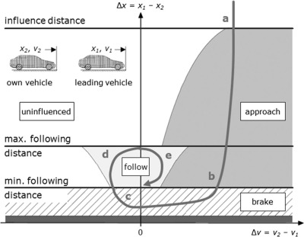
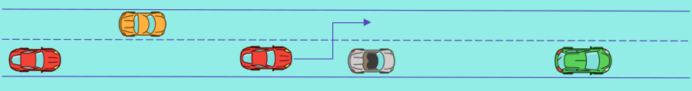
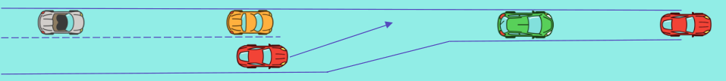
Simulation of driver + car particles
Simulering af different aspekter af bilisternes adfærd:
Car following - acceleration model, decided on acceleration depending on the speed difference and distance to the follower, extended with reaction times and imperfections in vehicle + driver particle.
Lane changing - decision on switching lane depending on the speeds and positions of the vehicles in next lane.
Others: merging, priority crossing, right of way inside signalized intersection, compliance to stopping / waiting at red / stopline etc.
All of those behaviours are modelled with mathematical expressions with parameters that have to be calibrated using real data for the model to replicate reality.
Active research field:
Mathematical description of different vehicle movement models: Treiber, M. m Kesting, A. 2013 - Traffic Flow Dynamics, Data, Models and Simulation
SUMO: https://sumo.dlr.de/docs/Definition_of_Vehicles%2C_Vehicle_Types%2C_and_Routes.html#car-following_models
Main model in VISSIM (also available in SUMO) http://w99demo.com/
Notes:
Almost every simulation package uses its own model for vehicle movement. Almost all models are so-called "car-following-models": the behavior of the driver is herein meant to be dependent on his distance to the vehicle in front of him and of this leading vehicle's speed.

Slide 11

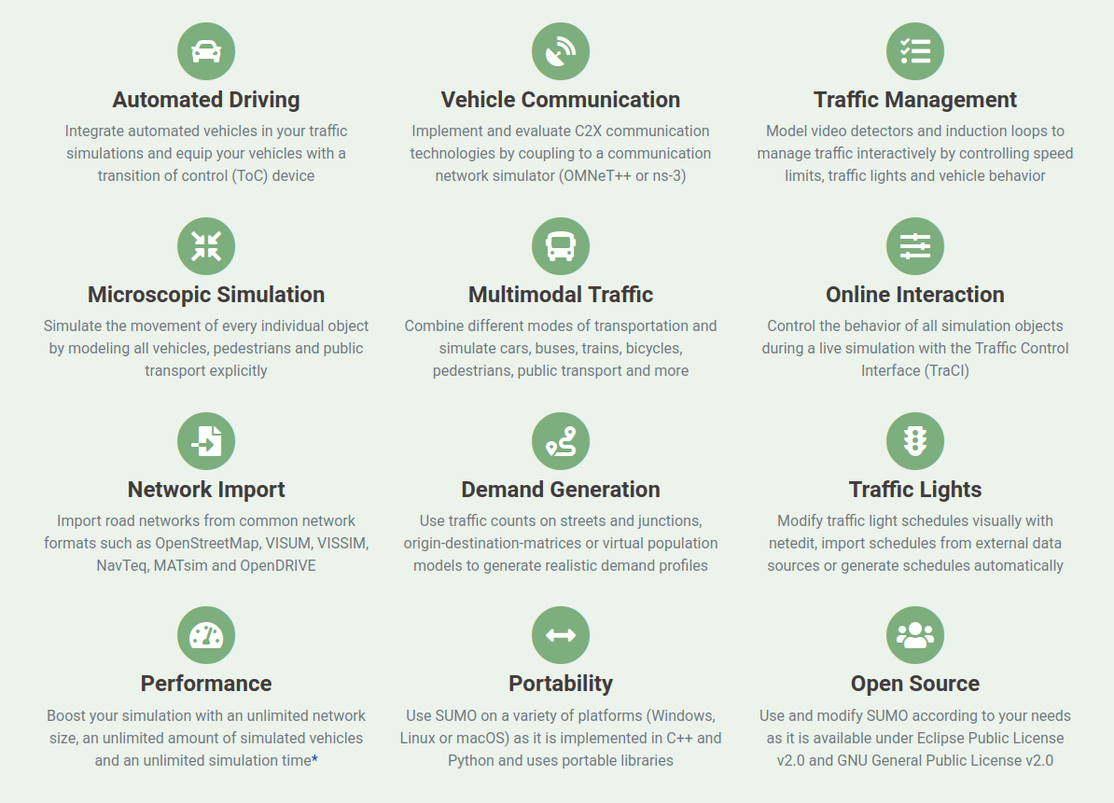
SUMO workshop part 1
Example 1: Building a simple road with netedit and sumo-gui
Example 2: Building the same road using node and edge files
https://www.eclipse.org/sumo/

Slide 12
SUMO expectations
Don’t expect a great colorful user interface, prepare to work a lot in terminal due to automation:
Open source toolbox, easier to add tools and models as they are developed rather than waiting for a big centralized software update.
SUMO is meant for more than manual network drawing and demand generation. applications such as online traffic prediction or multiple mass scale remote simulations require the tool to be easily configurable and runnable on a server / platform / cluster from a command terminal.
Very high potential for automation through python interface - TraCI.
Documentation is king, love the documentation!

Slide 13
Simulation scenario
Network definition: https://sumo.dlr.de/docs/Networks/SUMO_Road_Networks.html
Demand definition: https://sumo.dlr.de/docs/Demand/Introduction_to_demand_modelling_in_SUMO.html

Slide 14
Recap: command line i Win / macOS / Linux
cd - change directory
dir / ls - list files and folders in current path
where / which <filename> - show path to the file
for example python interpreter where python on Win and which python on macOS/Linux
or SUMO simulator executable where sumo on Win and which sumo on macOS/Linux
Opening / creating files with text editors (altid kan laves manuelt uden terminal)
Win: notepad somefile.txt or or start notepad++ somefile.txt
macOS/Linux nano somefile.txt
If you got VSCode code somefile.txt

Slide 15
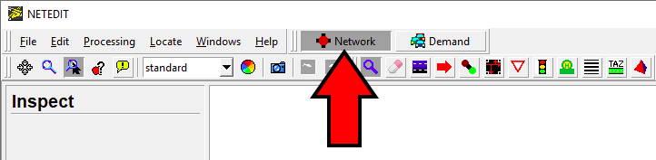
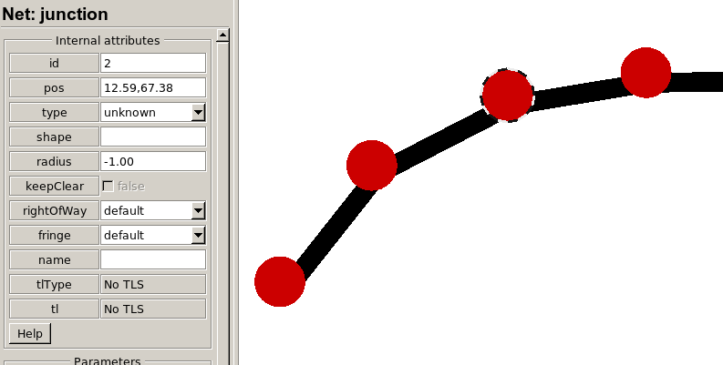
Example 1: Simple network with netedit
Based on https://sumo.dlr.de/docs/Tutorials/Hello_World.html
netedit - a program to edit SUMO network files *.net.xml
sumo-gui - to run and visualize simulation (GUI - guided user interface)
Open netedit using the icon or using command line / terminal (remember to cd into the correct folder)
Draw nodes
Inspect nodes and edges, change node names to 0,1,2… and edge names to 0to1, 1to2, …
Save network

Slide 16
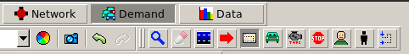
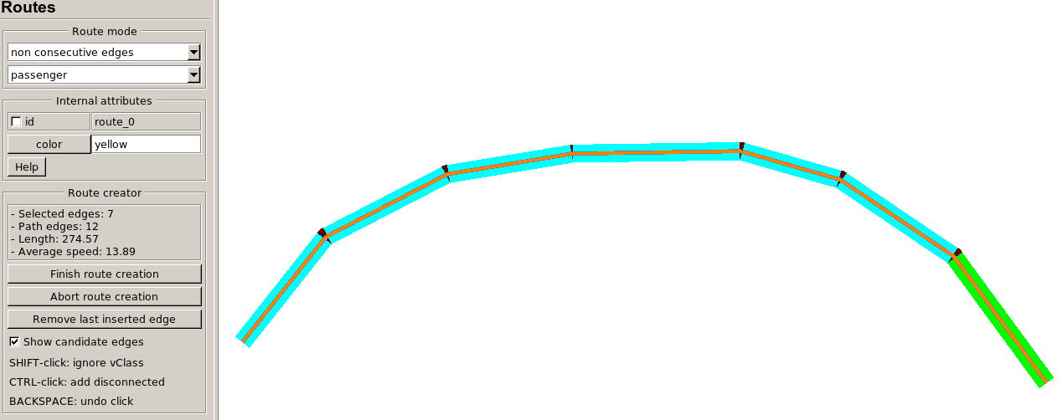
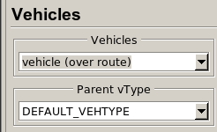
Example 1: Routes
Switch to Demand window (can use F3)
Press on routes icon (alternatively press R or Edit-> Route Mode) and pick edges
Press on vehicles icon (alternatively press V or Edit-> Vehicles Mode) and pick edges
Save demand file > Demand Elements > Save …
What sort of vehicle are we simulating, and what is the underlying car following model?
https://sumo.dlr.de/docs/Vehicle_Type_Parameter_Defaults.html
https://sumo.dlr.de/docs/Definition_of_Vehicles%2C_Vehicle_Types%2C_and_Routes.html#car-following_models
Simulation in sumo-gui
In netedit Edit > Open in sumo-gui
Set delay in sumo-gui to a bigger value and simulate
What else can we do with sumo-gui find in SUMO docs:
https://sumo.dlr.de/docs/sumo-gui.html
pick edges

Slide 17
SUMO xml files
XML - (Extensible Markup Language) defines rules to encode some data that is both human readable and easy to process by a computer. In SUMO all inputs and outputs are *.xml format.
Tags
start-tag, such as <container-name>
end-tag, such as </container-name>
element tag, such as <element-name parameter1=”something” parameter2=”nothing” parameter3=”42” />
Example: my_nodes.nod.xml
<nodes>
<node id="0" x="-100.0" y="-100.0"/>
<node id="1" x="0.0" y="0.0"/>
<node id="2" x="+100.0" y="100.0"/>
<node id="3" x="+400.0" y="200.0"/>
</nodes>

Slide 18
Example 2
Let`s compose the same model, but now manually, based on this doc:
https://sumo.dlr.de/docs/Networks/PlainXML.html
Network
Node file - *.nod.xml describes networks node positions
Edge file - *.edg.xml describes connectivity between nodes
Edge type file *.type.xml describes edge properties (speed, lane count, etc)
Network *.net.xml file is build with netconvert from 1 + 2 + 3
Routes
Route file - *.rou.xml describes routes and vehicles
*.nod.xml
*.edg.xml
*.type.xml
*.net.xml
*.rou.xml
sumo / sumo-gui

Slide 19
3 Files to build *.net.xml
In *.nod.xml
<nodes>
<node id="0" x="-1000.0" y="-1000.0"/>
<node id="1" x="0.0" y="-100.0"/>
<node id="2" x="+1000.0" y="800.0"/>
<node id="3" x="+2000.0" y="1500.0"/>
</nodes>
In *.edg.xml
<edges>
<edge from="0" to="1" id="entry" type="3L33.3"/>
<edge from="1" to="2" id="1_2" type="3L33.3"/>
<edge from="2" to="3" id="exit" type="3L33.3"/>
</edges>
In *.type.xml
<types>
<type id="3L33.3" numLanes="3" speed="33.3"/>
</types>
SUMO uses SI units, length in [m], speed in [m/s], time in [s]

Slide 20
Eksempel 2: *.net.xml
*.nod.xml
*.edg.xml
*.type.xml
*.nod.xml + *.edg.xml + *.type.xml = *.net.xml
netconvert --node-files my_nodes.nod.xml --edge-files my_edges.edg.xml --type-files my_types.type.xml --output-file my_net.net.xml
Or a shorter notation:
netconvert -n my_nodes.nod.xml -e my_edges.edg.xml -t my_types.type.xml -o my_net.net.xml
Remember we can always explore the network file in the netedit
netedit my_net.net.xml
Can also split any network back to its components:
netedit --sumo-net-file my_net.net.xml --plain-output-prefix netpart
What to do if in double about netconvert function?
Try netconvert --help
Or look up in the docs https://sumo.dlr.de/docs/netconvert.html
*.net.xml
*.rou.xml
sumo / sumo-gui

Slide 21
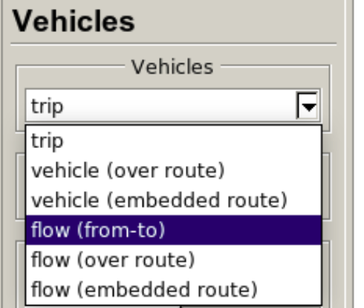
Eksempel 2: *.rou.xml
<routes>
<vType id="normal_car" vClass="passenger" maxSpeed="40" speedFactor="0.9" speedDev="0.2" sigma="0.5" />
<vType id="sporty_car" vClass="passenger" maxSpeed="60" speedFactor="1.3" speedDev="0.1" sigma="0.1" />
<vType id="trailer" vClass="trailer" maxSpeed="30" speedFactor="1.1" speedDev="0.1" />
<vType id="coach" vClass="coach" maxSpeed="30" speedFactor="1." speedDev="0.1" />
<flow id="normal_flow" type="normal_car" begin="0" end="5000" number="5000" from="entry" to="exit" departPos="last" departLane="best" />
<flow id="sporty_flow" type="sporty_car" begin="0" end="5000" number="300" from="entry" to="exit" departPos="last" departLane="best" />
<flow id="coach_flow" type="coach" begin="0" end="5000" number="300" from="entry" to="exit" departPos="last" departLane="best" />
<flow id="trailer_flow" type="trailer" begin="0" end="5000" number="700" from="entry" to="exit" departPos="last" departLane="best" />
<trip id="trailer_trip" depart="0" from="entry" to="exit" departPos="last" departLane="best"/>
</routes>
Standart Krauss car following model parameters accessible through .xml configuration files
accel – acceleration ability [m/s 2 ],
decel – deceleration ability [m/s 2 ],
sigma – driver imperfection (real value between 0 and 1 inclusive),
length – vehicle length (including a typical gap distance between stopped/parked vehicles) [m],
maxSpeed – vehicle maximum velocity [m/s],
tau – driver’s reaction time [s].
https://sumo.dlr.de/docs/Vehicle_Type_Parameter_Defaults.html
https://sumo.dlr.de/docs/Definition_of_Vehicles,_Vehicle_Types,_and_Routes.html#car-following_model_parameters
Notes:
speedFactor float default=1.0 The vehicles expected multiplicator for lane speed limits
speedDev float default=0.1 The deviation of the speedFactor;
sigma driver imperfection parameter in some SUMO car-following models [Krauss, SKOrig, PW2009, Kerner, IDM, ACC, CACC]

Slide 22
Lane changing properties
From vehicle perspective:
https://sumo.dlr.de/docs/Definition_of_Vehicles,_Vehicle_Types,_and_Routes.html#lane-changing_models
<vType id="selfish_car" lcStrategic="0.5" lcCooperative="0.0"/>
From network perspective:
https://sumo.dlr.de/docs/Networks/PlainXML.html#lane-specific_definitions
<lane … changeLeft=”car, bus”, changeRight=”car”/>
where:
changeLeft [list of vehicle classes] List of vehicle classes that may change left from this lane
changeRight [list of vehicle classes] List of vehicle classes that may change right from this lane

Slide 23
Example 2: simulation definition *.sumocfg
Simulation is specified in *.sumocfg
<configuration>
<input>
<net-file value="my_net.net.xml" />
<route-files value="my_routes.rou.xml" />
</input>
<time>
<begin value="0" />
<end value="5000" />
</time>
</configuration>
run it: sumo-gui -c my_config.sumocfg
What other parameters are available? https://sumo.dlr.de/docs/sumo.html
*.nod.xml
*.edg.xml
*.net.xml
*.type.xml
*.sumocfg
*.rou.xml
sumo / sumo-gui

Slide 24
Exercise 1
Model a 4 leg intersection with 1 lane each
Use netedit to create geometry (Remember good names, you will need them to assign demand)
Add connections for all turns except turnaround (Use netedit or create a *.con.xml file https://sumo.dlr.de/docs/Networks/SUMO_Road_Networks.html#connections)
* Help for 2 is somewhere in this doc: https://sumo.dlr.de/docs/Definition_of_Vehicles,_Vehicle_Types,_and_Routes.html
Create a *.rou.xml demand file in your text editor of choice
Define 3 routes on the intersection
Define a vehicle vType that has maximum speed of 50 and green color. Define a flow of the vehicles each route, that ends on timestep 500, simulate results in sumo-gui
Define a bus vType that has a maximum speed of 20 and red color. Define a trip for the busses during timesteps 100, 200, 300, 400, simulate results in sumo-gui
For the fast:
Split the approaches in 2 parts, on the part closest to the intersection junction add a lane, view the results in netedit
Add pedestrian lane to all edges, add crossings, create pedestrian routes and add pedestrian flows, simulate the results in sumo-gui

Slide 25
SUMO workshop part 2
More detailed demand generation
Output generation
Extra tips

Slide 26
Generating random trips
Simple version:
python $SUMO_HOME/tools/randomTrips.py -n test.net.xml -o test.rou.xml --period 5 -b 5 -e 105
More advanced version, with prefixes, random seeds and edge weights:
python $SUMO_HOME/tools/randomTrips.py -n block.net.xml -o vehicles.rou.xml --period 5 --prefix "v"
--seed 42 --weights-prefix edge_weights --validate --end=3600
Remember different slash and env variable name on Windows:
python %SUMO_HOME%\tools\randomTrips.py

Slide 27
Outputs
Diverse output muligheder per timestep / køretøj
Floating car data (FCD): Position, Speed, Vehicle angle - like a GPS device
Network related data: occupied lane, edge, lane change and reason
Emission-output CO2, CO, Nox, etc.
Time to collision, brake rate, bumper to bumper distance, DRAC, deceleration to avoid crash
More in experimental and under development
Run without GUI if we dont want to visualize it (better for performance)
sumo -c my_config.sumocfg --tripinfo-output my_tripinfo.xml

Slide 28
Another way, include into the config
<configuration>
<input>
<net-file value="my_net.net.xml" />
<route-files value="my_routes.rou.xml" />
</input>
<output>
<fcd-output value="my_fcd.xml" />
<emission-output value="my_emission.xml" />
<tripinfo-output value="my_tripinfo.xml" />
</output>
<time>
<begin value="0" />
<end value="5000" />
</time>
</configuration>
Which keywords to use for output types?: https://sumo.dlr.de/docs/sumo.html#output

Slide 29
Working with output
Library of python tools
https://sumo.dlr.de/docs/Tools/
For example: xml to csv conversion
https://sumo.dlr.de/docs/Tools/Xml.html
Linux / macOS python $SUMO_HOME/tools/xml/xml2csv.py my_fcd.xml
Windows python %SUMO_HOME%\tools\xml\xml2csv.py my_fcd.xml

Slide 30
Naming dos / donts
https://sumo.dlr.de/docs/Networks/PlainXML.html#edge_descriptions
Caution: there are some constraints about the edge names in the xml file. They must not contain any of the following characters:
'_' underline - used for lane ids
'[' and ']' used for xml enumerations
' ' space - used as xml list element divider
'*' star, used as wildcard for xml query
':' used as marker for internal lanes
Examples:
‘Edge1to2’ - good
‘Edge12’ - also good
‘edge1_2’ - bad, collides with name of lane 1 of edge 1
‘edge from one to two‘ - bad, spaces are not allowed

Slide 31
netconvert / netedit responsibilities
What you define on a network
Nodes
Edges
Connections
Traffic lights
Detectors
What netconvert / netedit calculates (can be influenced)
Internal edges that match <connection> definitions to guide users through intersections
Walking areas whenever there are pedestrian paths and zebra crossings
*.edg.xml
*.nod.xml
*.type.xml
*.con.xml
*.tll.xml
Edit to modify the network
netconvert or netedit
Dont open!
*.net.xml
Edit to modify the simulation settings
*.sumocfg

Slide 32
Exercise 2
Model your favourite street in Aalborg that contains at least 3 intersections.
Model your favourite street in Aalborg that contains at least 3 intersections. Figure out how draw the network on top of a background image layer with https://sumo.dlr.de/docs/sumo-gui.html#showing_background_images and https://www.youtube.com/watch?v=rTT0vKzikpg&ab_channel=AkharapongTepkeaw links.
Find a way to add bicycle lanes using netconvert
Experiment with adding different demands:
Single trips
Flows
randomTrips.py with / or without edge weights
For the fast:
Try defining the demands using the turn ratios https://sumo.dlr.de/docs/Tools/Turns.html
Try defining the demands using the OD matrix with od2trips tool: https://sumo.dlr.de/docs/Demand/Importing_O/D_Matrices.html

Slide 33
Summary: What have we learnt today?
Got introduction to traffic simulation and SUMO
Have built a couple of simple sumo networks
Got an understanding of how SUMO input and output can be defined using xml files

Slide 34
References
[1] Treiber, M. m Kesting, A. 2013 - Traffic Flow Dynamics, Data, Models and Simulation, DOI: 10.1007/978-3-642-32460-4

